Slide 1
Breast Cancer
Jacob Blizzard
Megan Eckstein
Jeff Griffiths
Tess Newkold

Slide 2
Objective

Slide 3
To accurately predict whether the tumor cells are malignant or benign using various data mining techniques.

Slide 4
Agenda
Classification Tree
R
SPSS
Python
Support Vector Machine (SVM) Classifier
R - “e1071” package
SPSS
Python

Slide 5
Data

Slide 6
Data Dimension
Attributes
ID Number
Clump Thickness
Uniformity of Cell Size
Uniformity of Cell Shape
Marginal Adhesion
Single Epithelial Cell Size
Bare Nuclei
Bland Chromatin
Normal Nucleoli
Mitosis
Diagnosis
699 Observations
10 Predictor Variables
1 Response Variable

Slide 7
Exploratory Data Analysis

Slide 8
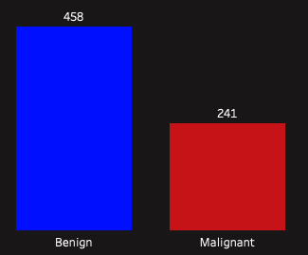
Tumor Diagnosis
Cell Shape Uniformity
Bare Nuclei

Slide 9
Results

Slide 10
Classification Tree

Slide 11
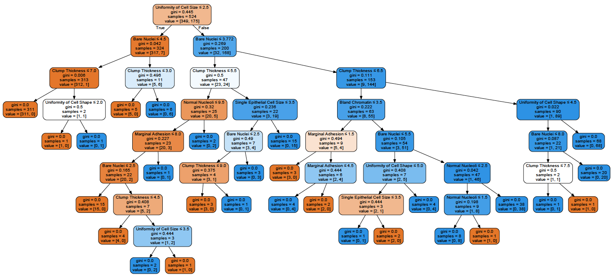
Python

Slide 12
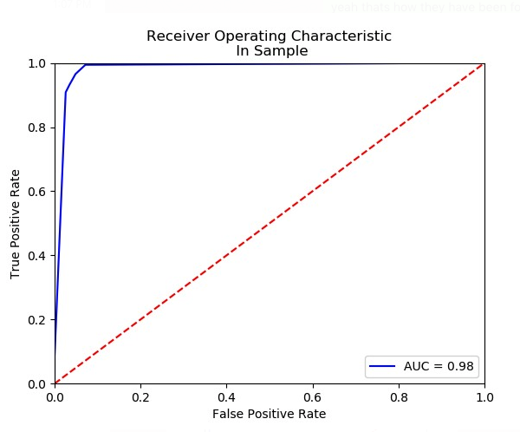
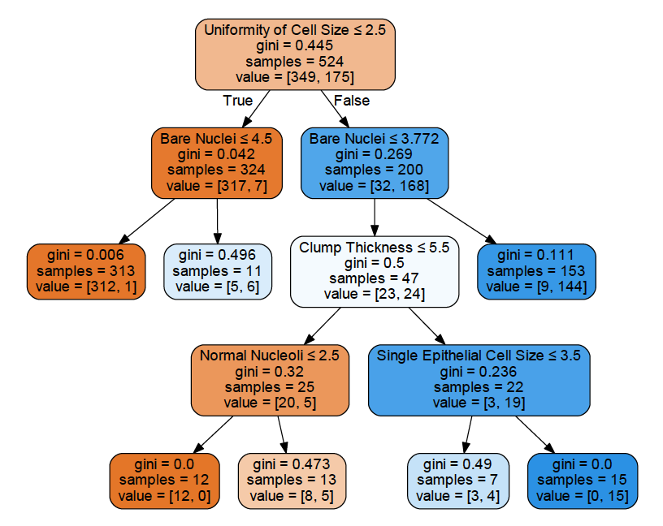
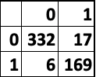
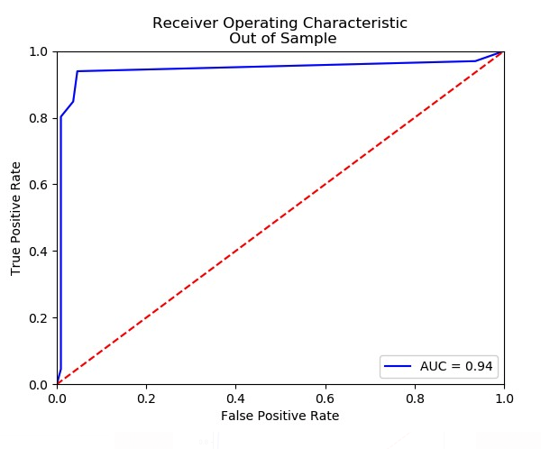
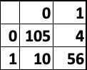
“Pruning” In Python
MR
4.39%
AUC
0.98
MR
8.0%
AUC
0.94

Slide 13
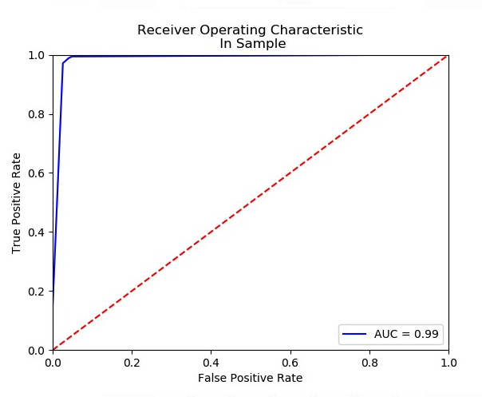
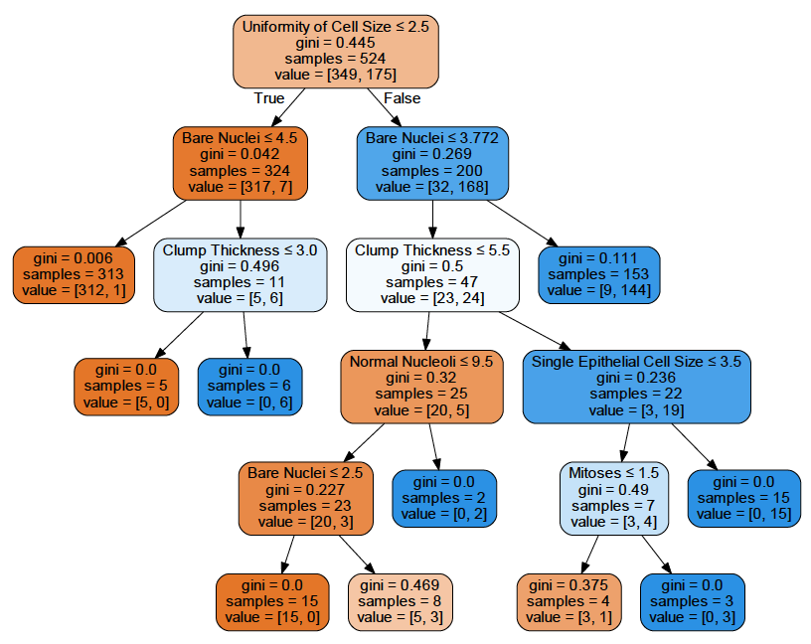
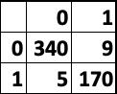
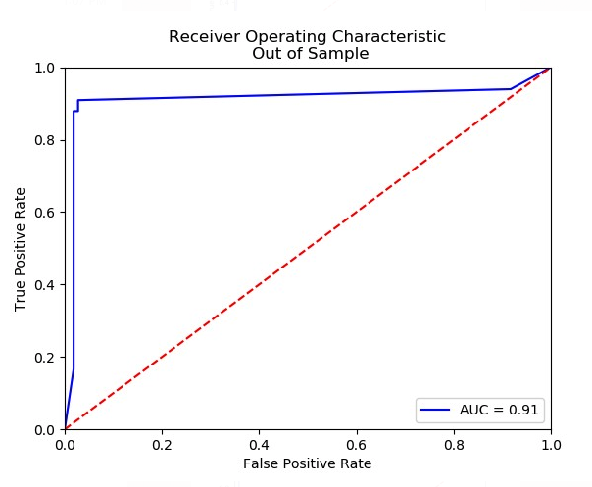
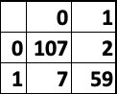
“Pruning” In Python
MR
2.67%
AUC
0.99
MR
5.14%
AUC
0.91

Slide 14
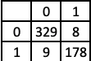
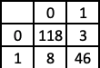
R
In-Sample
AUC
0.979
MR
3.2%
Out-of-Sample
AUC
0.967
MR
6.3%

Slide 15
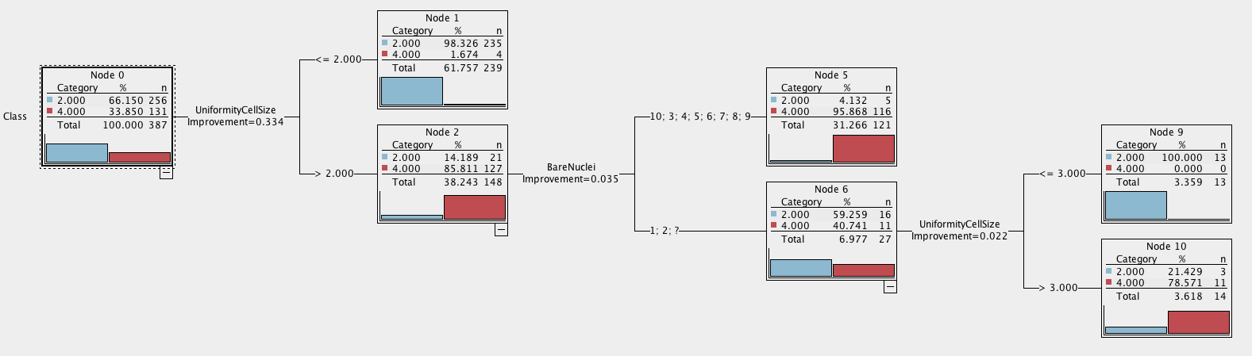
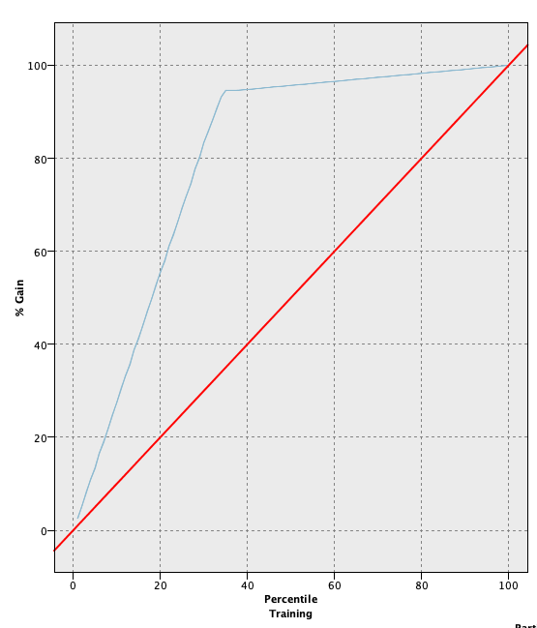
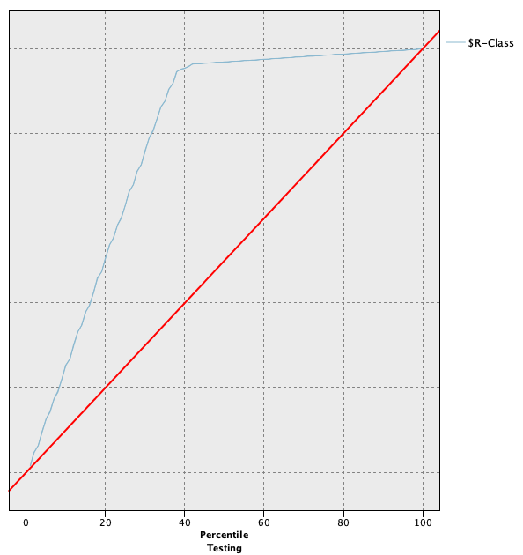
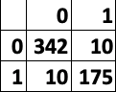
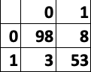
SPSS Modeler
AUC
0.96
MR
3.72%
AUC
0.946
MR
6.79%

Slide 16
Support Vector Machine

Slide 17
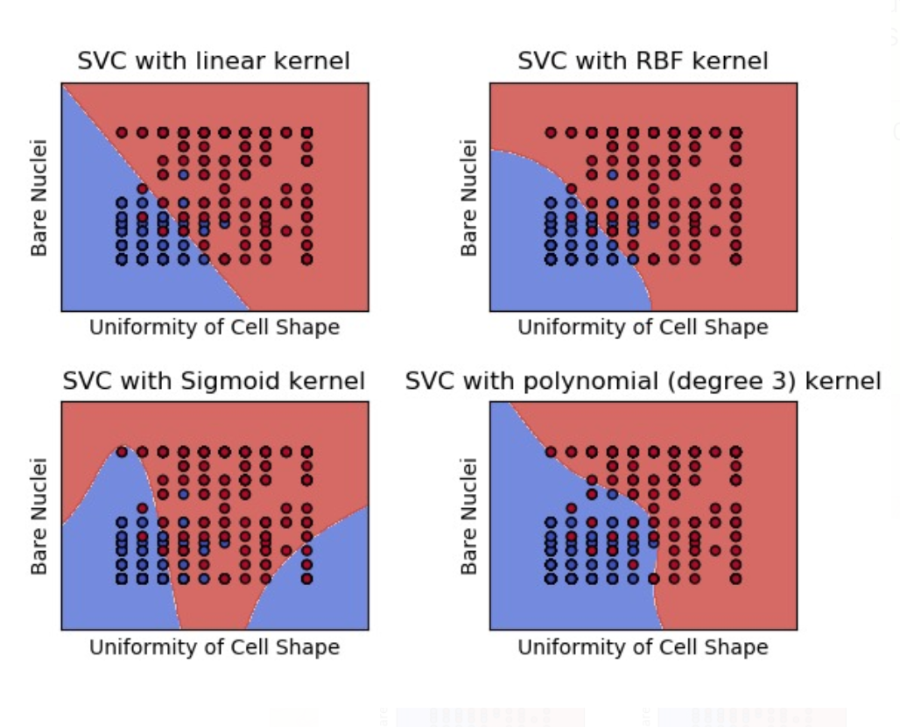
Python

Slide 18
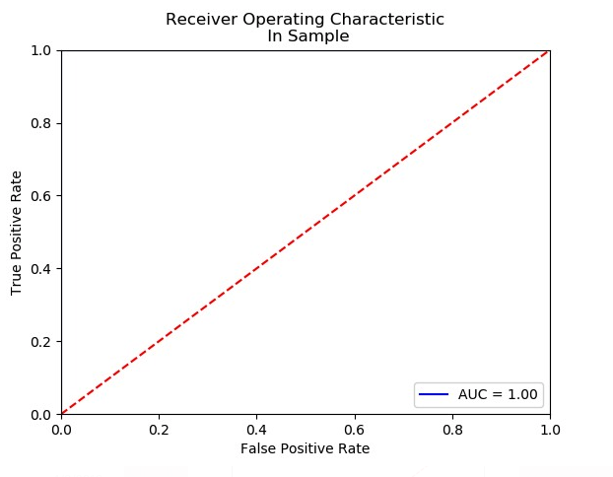
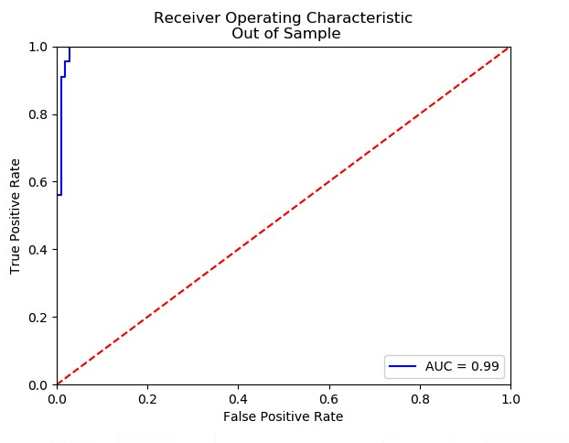
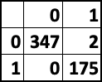
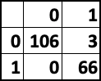
Python
AUC
1.0
In-Sample
Out-of-Sample
MR
0.38%
MR
1.7%
AUC
0.99

Slide 19
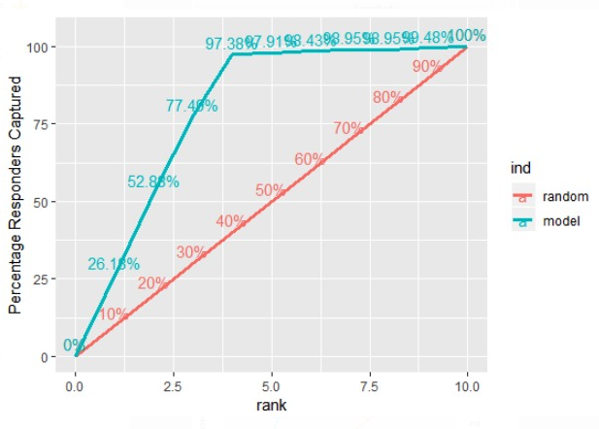
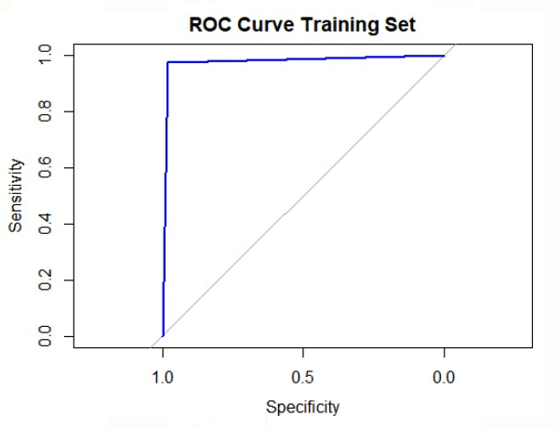
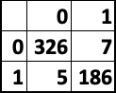
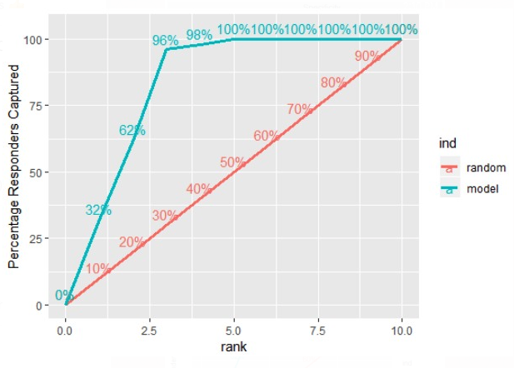
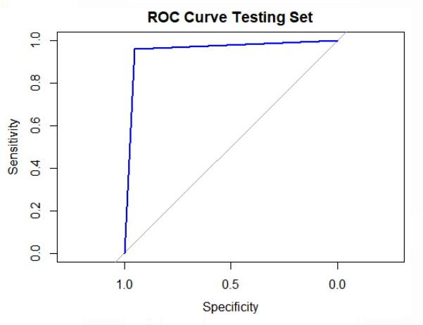
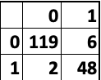
R
In-Sample
AUC
0.976
MR
2.3%
Out-of-Sample
AUC
0.956
MR
4.6%

Slide 20
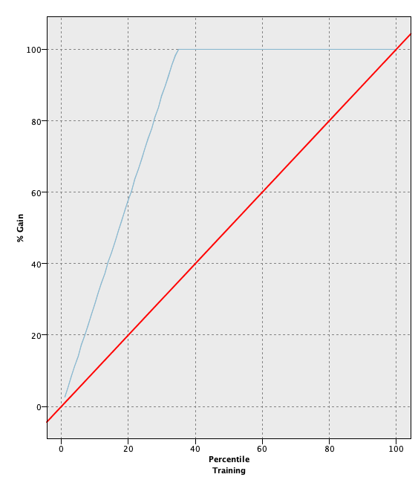
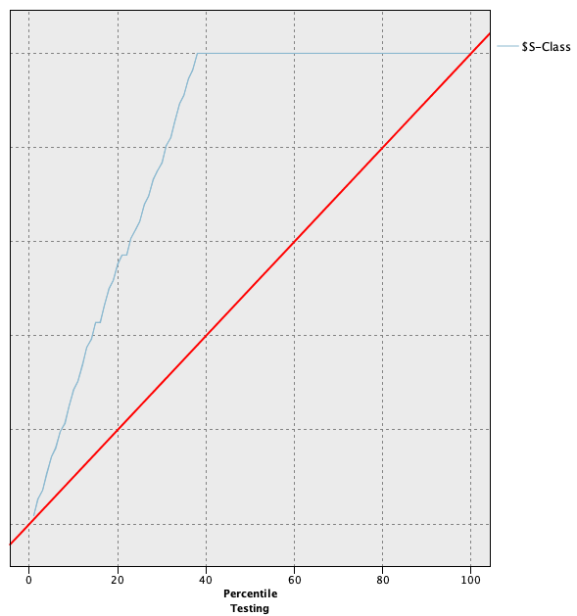
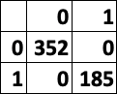
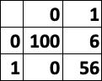
SPSS Modeler
In-Sample
Out-of-Sample
AUC
1.0
AUC
0.981
MR
0.0%
MR
3.7%

Slide 21


